Slide 1

Physical Electronics Ⅱ
Semiconductor Electronics Ⅱ
TCAD simulation : MOSFET

Slide 2
Content
Introduction
Long channel MOSFET
Body effect
Non-ideal effects
Short channel effects
Summary

Slide 3
Content
Introduction
Long channel MOSFET
Body effect
Non-ideal effects
Short channel effects
Summary

Slide 4

Reference
1 μm 공정은 1980년대 쓰이던 공정 기술
이시기에 상용화된 제품 중 Intel386TM SX MICROPROCESSOR data sheet 참고
동작 전압 5.0 V로 설정하여 시뮬레이션 진행

Slide 5
Device structure
Gate (TiN)
Gate oxide (SiO₂)
T_{ox}
Source
N_{sd}
Drain
N_{sd}
T_{sd}
L_{g}
T_{body}
L_{sd}
Body
N_{body}
Parameters | Values
L_{g} | 1 μm
L_{sd} | 0.5 μm
T_{body} | 1.2 μm
T_{sd} | 0.3 μm
T_{ox} | 0.02 μm
N_{body} | Boron 10¹⁷ cm⁻³
N_{sd} | Arsenic 10²⁰ cm⁻³
S/D Gaussian factor | 0.35

Slide 6
Content
Introduction
Long channel MOSFET
Body effect
Non-ideal effects
Short channel effects
Summary

Slide 7
Operation region
V_{GS} -1.0 V ~ 3.0 V
Accumulation
Flat band
Gate (TiN)
V_{DS} 5.0 V
Gate oxide (SiO₂)
Source
N_{sd}
Drain
N_{sd}
cut-line
Body
N_{body}
M
O
S
M
O
S
Depletion
Threshold
Strong inversion
M
O
S
M
O
S
M
O
S

Slide 8
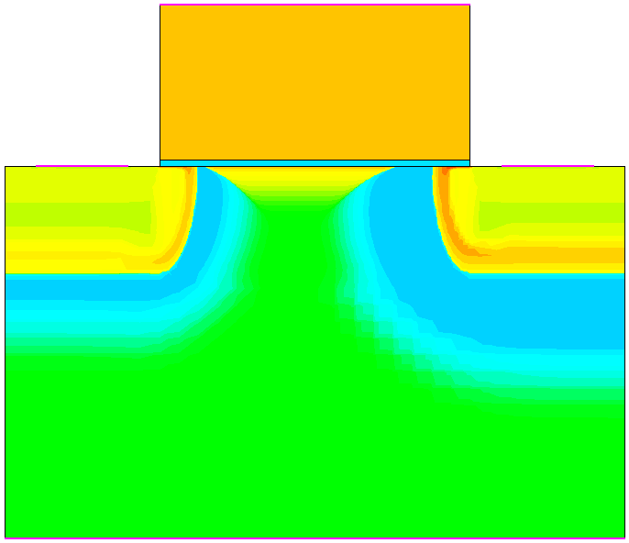
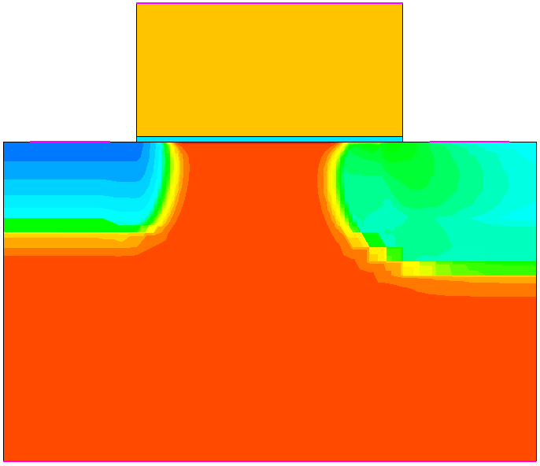
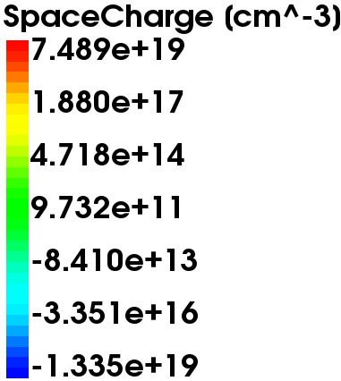
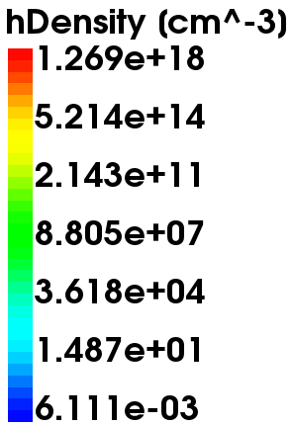
Operation region (Accumulation)
Accumulation
M
O
S

Slide 9
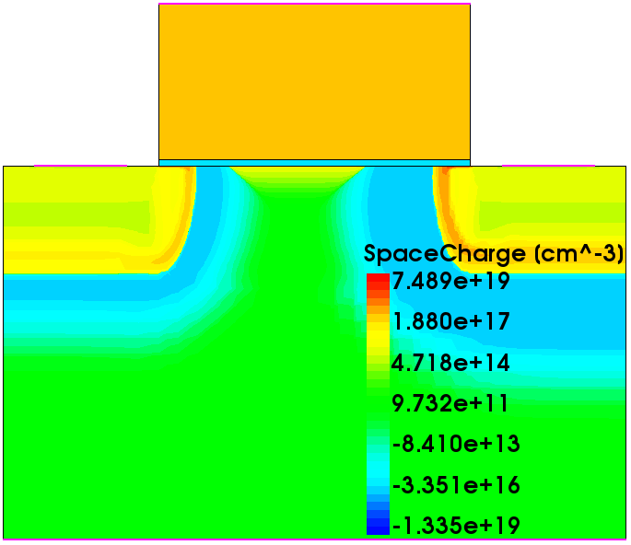
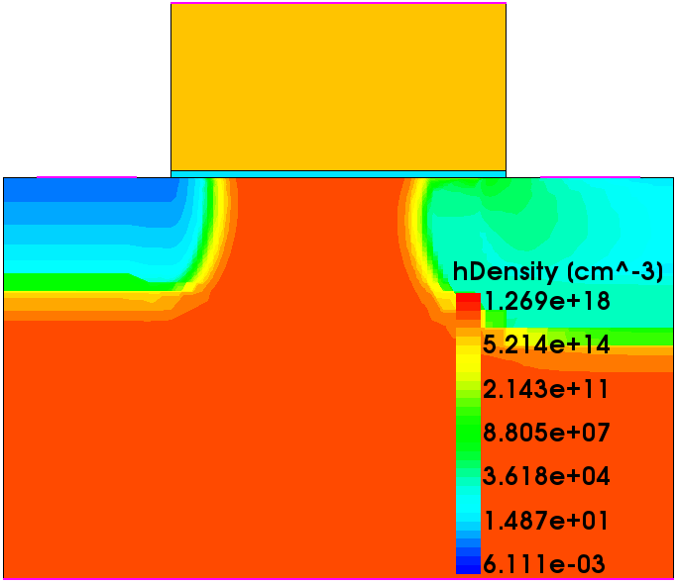
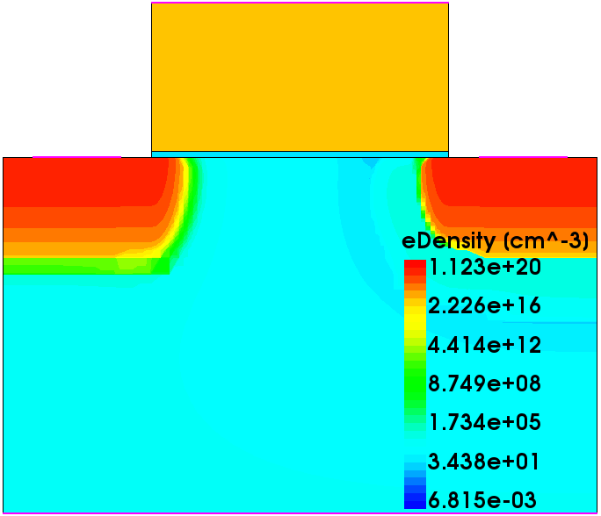
Operation region (Flat band)
Flat band
M
O
S

Slide 10
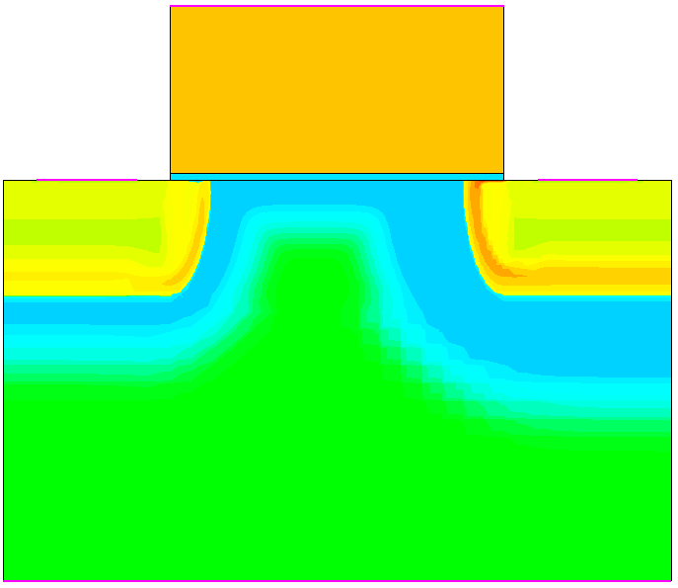
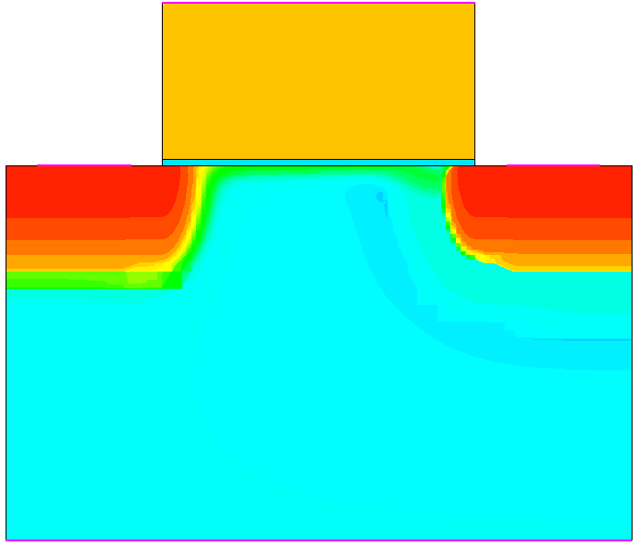
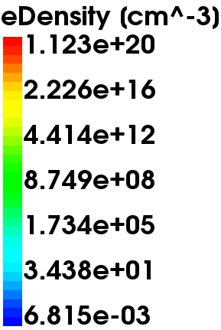
Operation region (Depletion)
Depletion
M
O
S

Slide 11
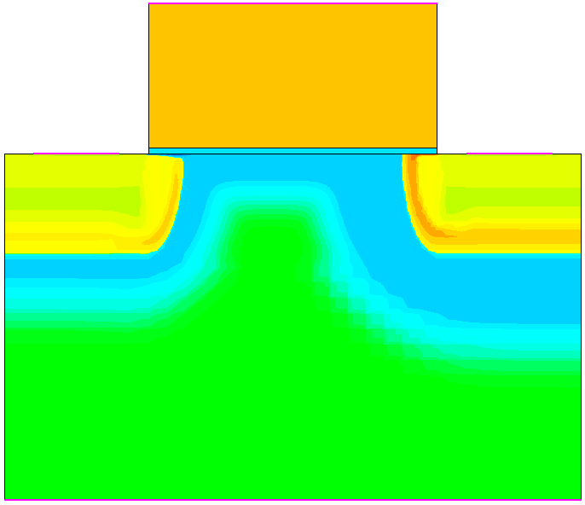
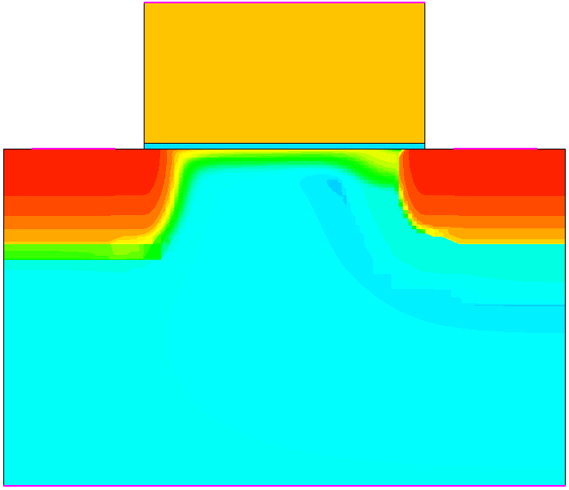
Operation region (Threshold)
Threshold
M
O
S

Slide 12
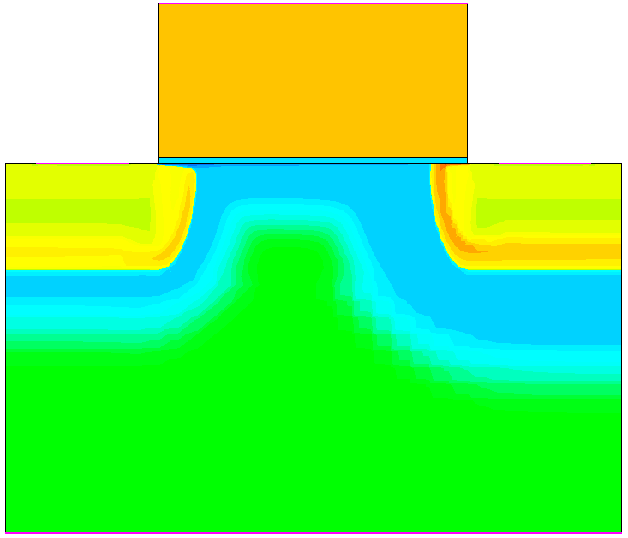
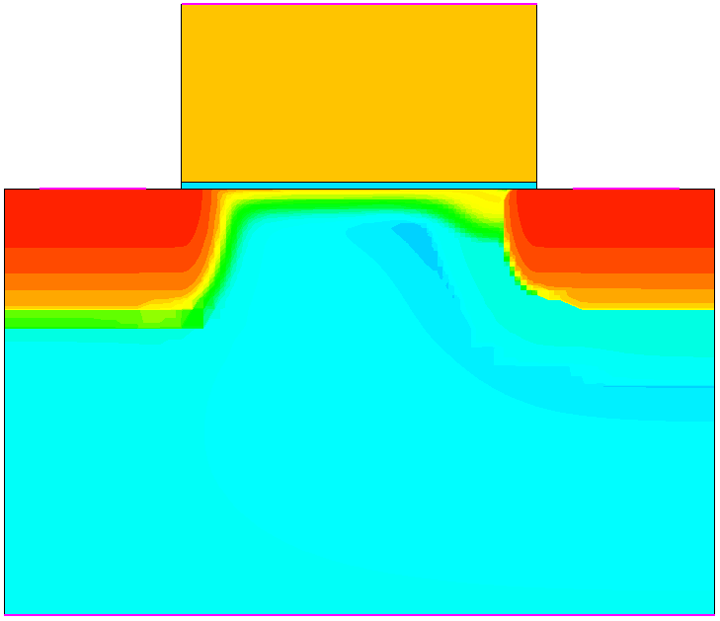
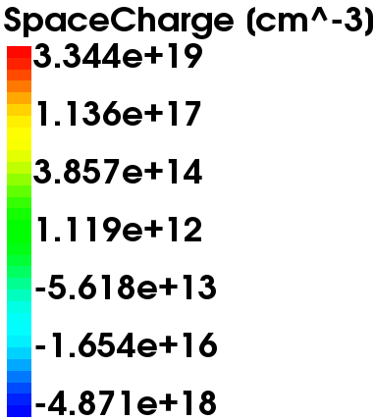
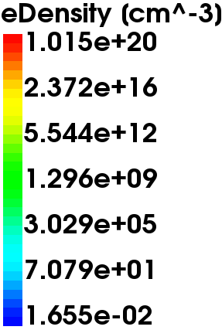
Operation region (Strong inversion)
Strong inversion
M
O
S

Slide 13
Content
Introduction
Long channel MOSFET
Body effect
Non-ideal effects
Short channel effects
Summary

Slide 14
Body effect
L_{g} = 1.00 μm
V_{GS} -1.0 V ~ 3.0 V
Gate (TiN)
V_{DS} 5.0 V
Gate oxide (SiO₂)
Body effect
Source
N_{sd}
Drain
N_{sd}
Body
N_{body}
V_{BS} 0.0, -1.0, -2.0 V
V_{BS} [V] | V_{th} [V]
0.0 | 1.37
-1.0 | 1.81
-2.0 | 2.12
V_{th} 증가
Inspect tool 활용하여 V_{th} 추출

Slide 15
Body effect
V_{GS} 0.0 V
Gate (TiN)
V_{DS} 0.0 V
Gate oxide (SiO₂)
Source
N_{sd}
cut-line
Drain
N_{sd}
Body
N_{body}
V_{BS} 0.0, -1.0, -2.0 V
M
O
S
M
O
S
M
O
S

Slide 16
Content
Introduction
Long channel MOSFET
Body effect
Non-ideal effects
Short channel effects
Summary

Slide 17
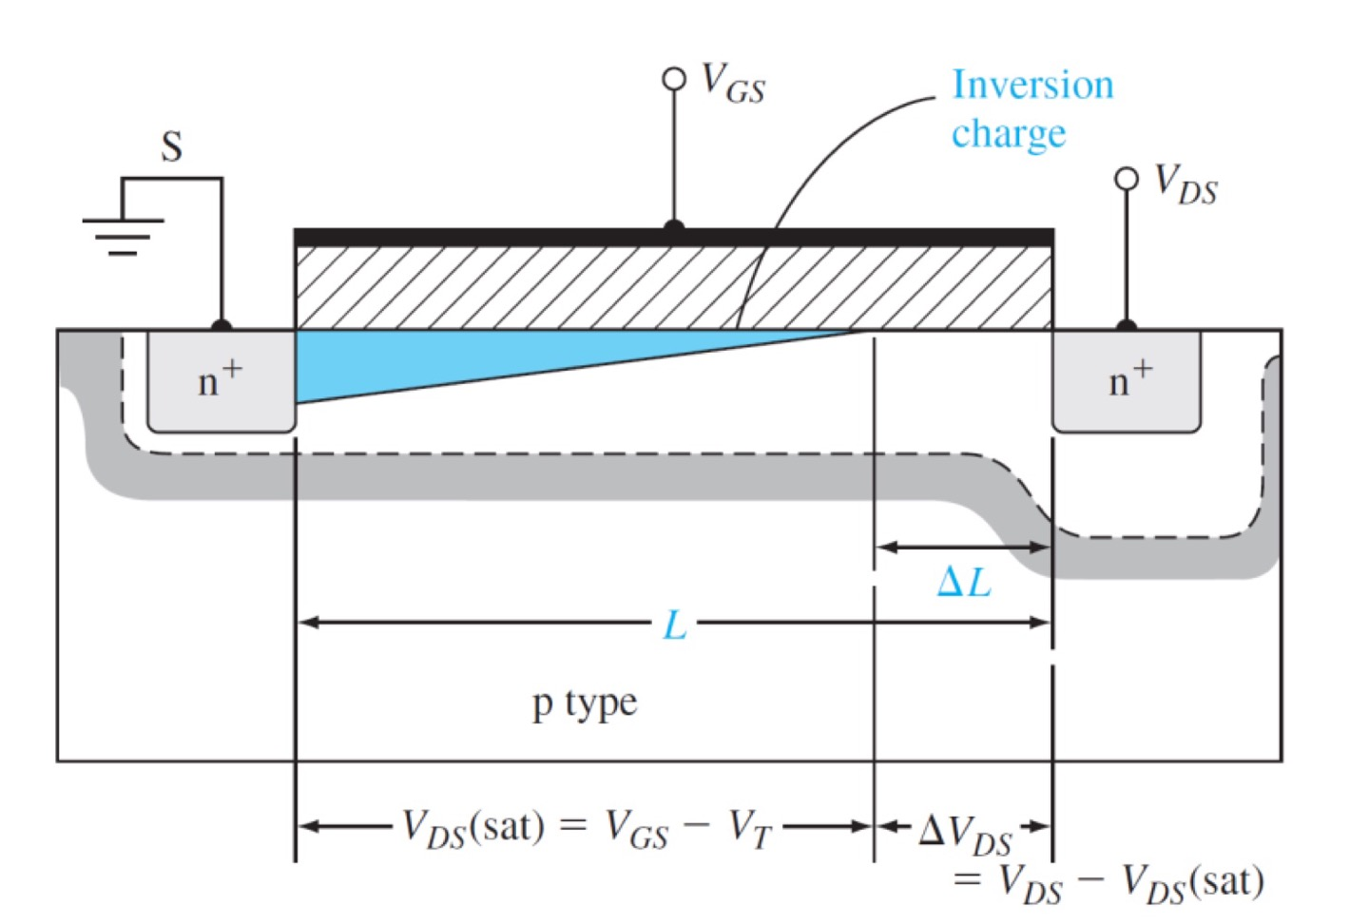


Channel length modulation
L_{g} = 1.00 μm
L_{g} = 0.48 μm
channel length
modulation
$$I_{D,sat}=\frac{1}{2}μ_{n}C_{ox}\frac{W}{L}{\left(V_{GS}−V_{th}\right)}^{2}$$
${{∴I}^{′}}_{D}=\left(\frac{L}{L−∆L}\right)$ $I_{D,sat}$

Slide 18

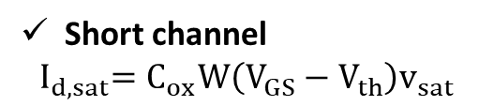
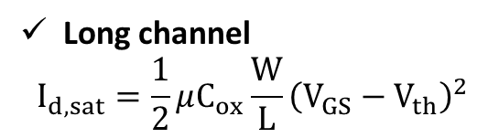

Velocity saturation
L_{g} = 1.00 μm
L_{g} = 0.48 μm
$$∝ \left(V_{GS}−V_{th}\right)$$
$$∝ {\left(V_{GS}−V_{th}\right)}^{2}$$
Long channel
$$I_{d,sat}=\frac{1}{2}μC_{ox}\frac{W}{L}{\left(V_{GS}−V_{th}\right)}^{2}$$
Short channel
$${ I}_{d,sat}=C_{ox}W\left(V_{GS}−V_{th}\right)v_{sat}$$
Physics의 mobility ( HighFieldSaturation )
적용시 Velocity saturation 구현 가능

Slide 19
Content
Introduction
Long channel MOSFET
Body effect
Non-ideal effects
Short channel effects
Summary

Slide 20
I_{D}-V_{G}
Punch-through
V_{th} roll-off
GIDL

Slide 21
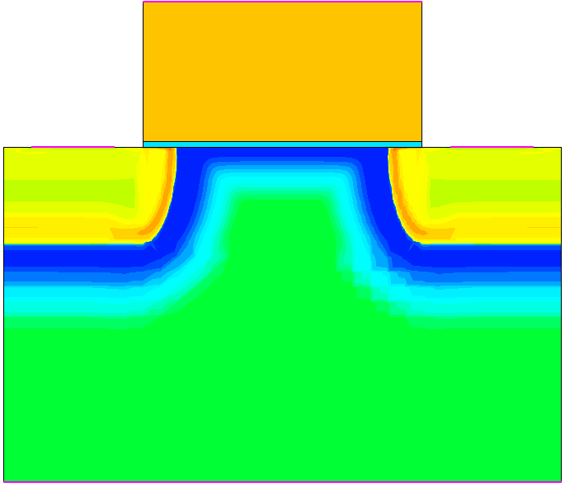
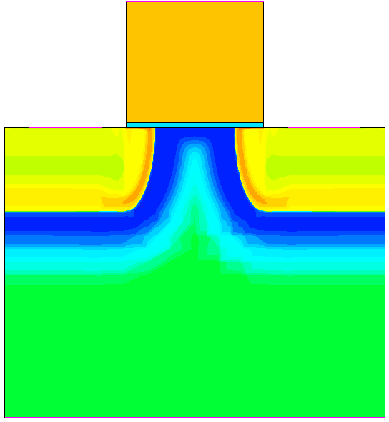
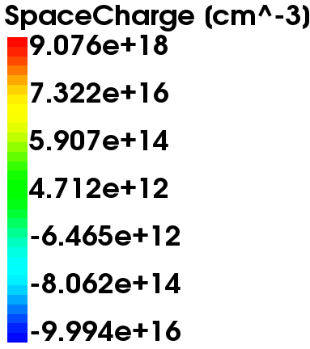
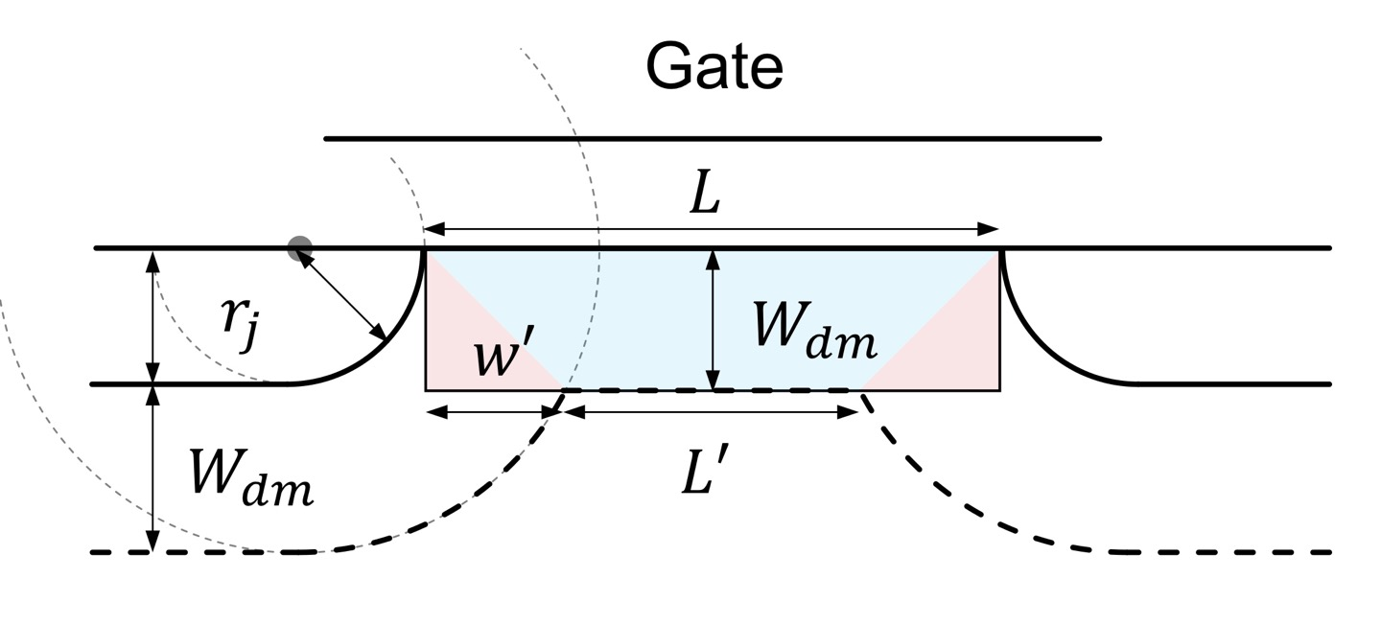
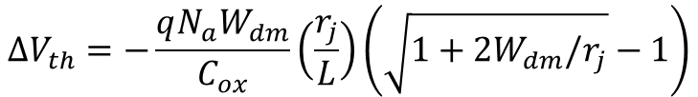
V_{th} roll-off
L_{g} = 1.00 μm
L_{g} = 0.57 μm
$$∆V_{th}=−\frac{qN_{a}W_{dm}}{C_{ox}}\left(\frac{r_{j}}{L}\right)\left(\sqrt{1+2W_{dm}/r_{j}}−1\right)$$

Slide 22
V_{th} roll-off
V_{th} roll-off
L_{g} [μm] | V_{th} [V]
1.00 | 1.37
0.57 | 1.04
0.48 | 0.58
0.45 | 0.13
V_{th}는 I_{D} = 10⁻⁷ A/μm x (W/L) [A/μm] 에서 추출
(강의 자료 W10-2 p.366 참고)

Slide 23
DIBL
High V_{DS} = 5.0 V, Low V_{DS} = 0.1 V
L_{g} = 1.00 μm
source
channel
drain
DIBL
L_{g} = 0.57 μm
source
channel
drain
* V_{th} (inspect tool) 추출 하여
DIBL 계산
L_{g} [μm] | DIBL [mV/V]
1.00 | 4.49
0.57 | 53.27

Slide 24
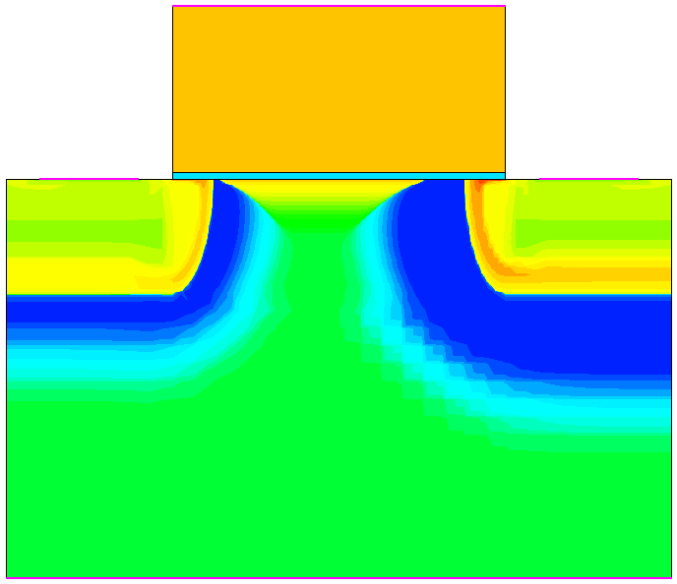
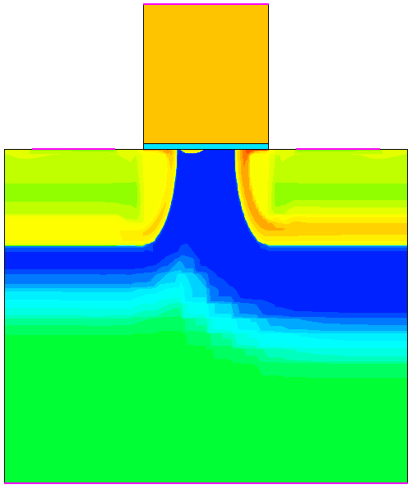
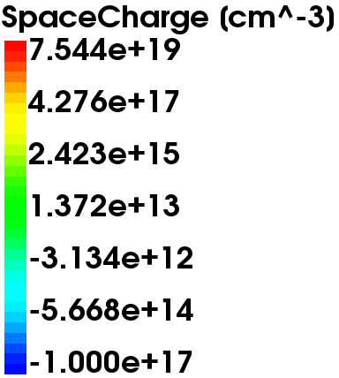
Punch through
V_{GS} = -1.0 V, V_{DS} = 5.0 V
L_{g} = 1.0 μm
L_{g} = 0.45 μm
punch through

Slide 25
Punch through
V_{GS} = -1.0 V, V_{DS} = 5.0 V
source
channel
drain
barrier
L_{g} = 0.45 μm
cut-line
cut-line
source
bulk
drain
drift

Slide 26
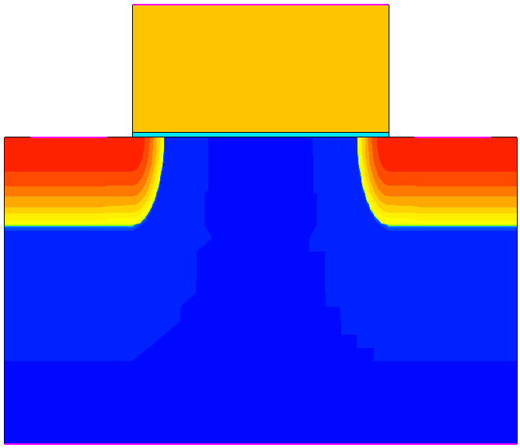
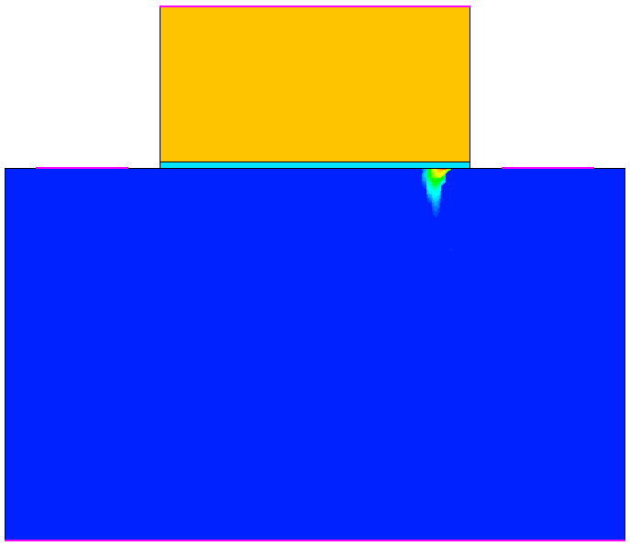
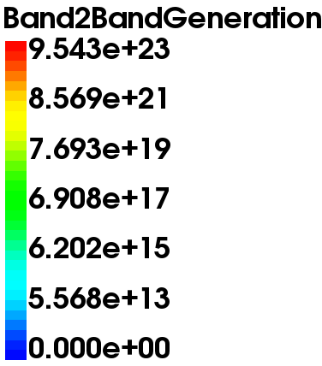
GIDL
V_{GS} = -1.0 V, V_{DS} = 5.0 V
source
channel
drain
SiO₂
drain
Physics의 recombination (Band2Band (E1))
적용시 BTBT구현 가능
* band-to-band-tunneling (BTBT)
BTBT
BTBT
gate
L_{g} = 1.00 μm
Over lap
cut-line
cut-line

Slide 27
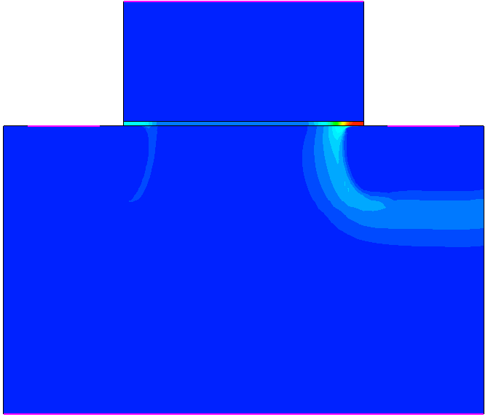
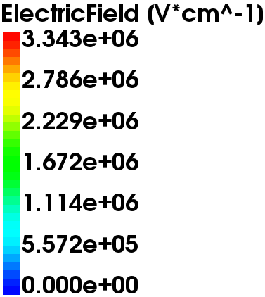
GIDL
V_{GS} = -1.0 V, V_{DS} = 5.0 V
L_{g} = 1.00 μm
High E-field
cut-line

Slide 28
Content
Introduction
Long channel MOSFET
Body effect
Non-ideal effects
Short channel effects
Summary

Slide 29
Summary
I_{D}-V_{D}
Channel length
decrease
I_{D}-V_{G}
L_{g} [μm] | V_{th} [V] | SS [mV/dec] | DIBL [mV/V]
1.00 | 1.37 | 111.63 | 4.49
0.57 | 1.04 | 108.99 | 53.27
0.48 | 0.58 | 131.83 | 124.29
0.45 | 0.13 | 337.94 | 202.86

